Slide 1
Inheritance concept in java
N.Vamsi krishna

Slide 2
In object-oriented programming, a subclass and superclass are related classes that are part of an inheritance hierarchy.
In Java, the extends keyword is used to create a subclass that inherits from a superclass.

Slide 3
Superclass
A superclass, also known as a parent class,
Is a class that serves as a base for one or more subclasses.
It provides common properties and behaviors that the subclass can inherit and reuse.
A superclass can be extended to add new properties and behaviors, but its own properties and behaviors remain unchanged.

Slide 4
Subclass
A subclass, also known as a child class.
Is a class that inherits properties and behaviors from a superclass.
It can also add new properties and behaviors that are specific to the subclass.
The subclass can override properties and methods of its superclass to provide its own implementation.

Slide 5
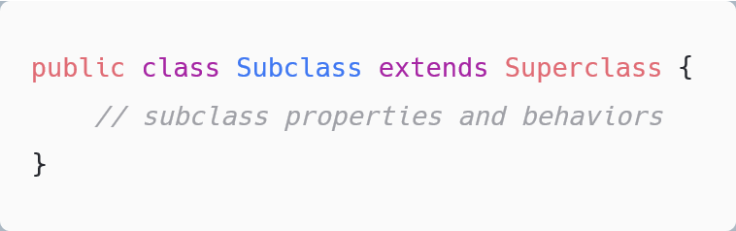
Inheritance
In Java, inheritance is a mechanism that allows a class to inherit properties and behaviors from a parent class, also known as a superclass. The child class, also known as the subclass, can extend the functionality of the superclass by adding its own properties and behaviors.
To create a subclass that inherits from a superclass in Java, you can use the extends keyword.
Syntax:

Slide 6
Why do we need it?
Code Reusability: The code written in the Superclass is common to all subclasses. Child classes can directly use the parent class code.
Method Overriding: Method Overriding is achievable only through Inheritance. It is one of the ways by which java achieves Run Time Polymorphism.
Abstraction: The concept of abstract where we do not have to provide all details is achieved through inheritance. Abstraction only shows the functionality to the user.

Slide 7
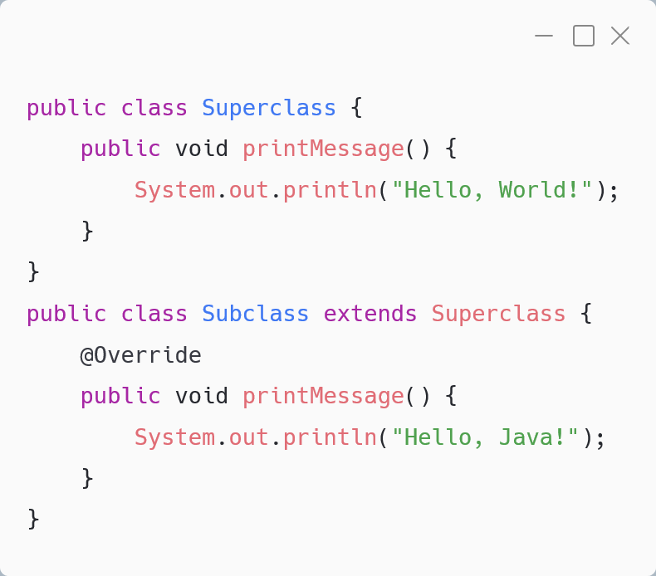
Overriding
When a subclass overrides a method of its superclass
It provides a new implementation of the method.
This is known as method overriding
In this example, ‘Subclass’ overrides the ‘printMessage()’ method of its superclass ‘Superclass’ with a new implementation that prints "Hello, Java!" instead of "Hello, World!". When you create an object of the Subclass and call the ‘printMessage()’ method, it will execute the implementation of the ‘Subclass’ and print "Hello, Java!" to the console.

Slide 8
In java, there are five type of inheritances
Single inheritance
Multilevel inheritance
Hierarchical inheritance
Multiple inheritance
Hybrid inheritance

Slide 9
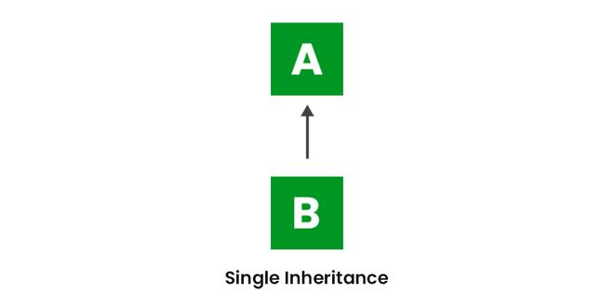
Single Inheritance
A subclass inherits properties and behaviors from a single superclass. In Java, you can use the extends keyword to create a single inheritance relationship between two classes.
Single inheritance allows for code reuse and promotes the idea of class hierarchy. It is one of the fundamental concepts of object-oriented programming in Java.

Slide 10
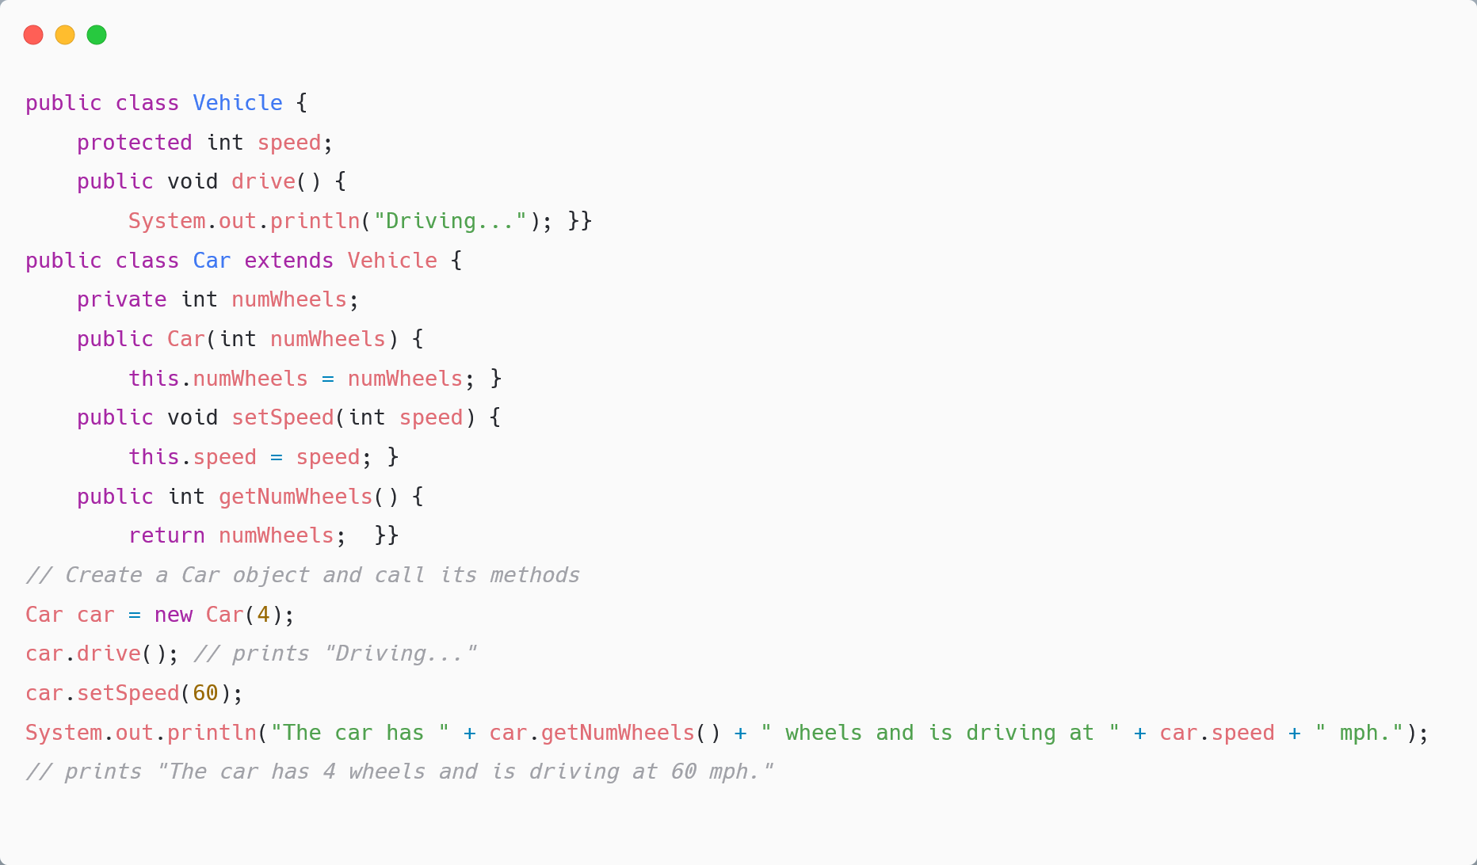
Example
In this example, Car is a subclass of Vehicle, and it inherits the drive() method and the speed property from its superclass. The Car class adds a new property numWheels and a new method getNumWheels(), which are specific to cars.

Slide 11
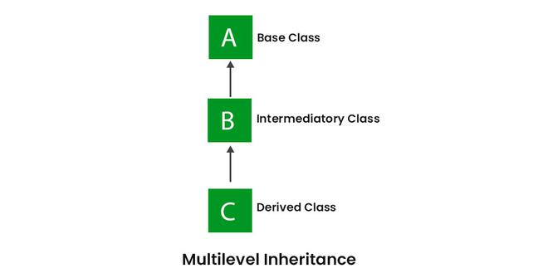
Multilevel inheritance
A subclass inherits properties and behaviors from a superclass, which in turn inherits from another superclass, and so on. In Java, you can create multilevel inheritance relationships by chaining extends keywords.
Multilevel inheritance can be useful when you want to create a hierarchy of classes with increasing levels of specialization. However, it can also lead to complex code and potential issues with method overriding and name clashes. It is important to design inheritance relationships carefully and use them appropriately.

Slide 12
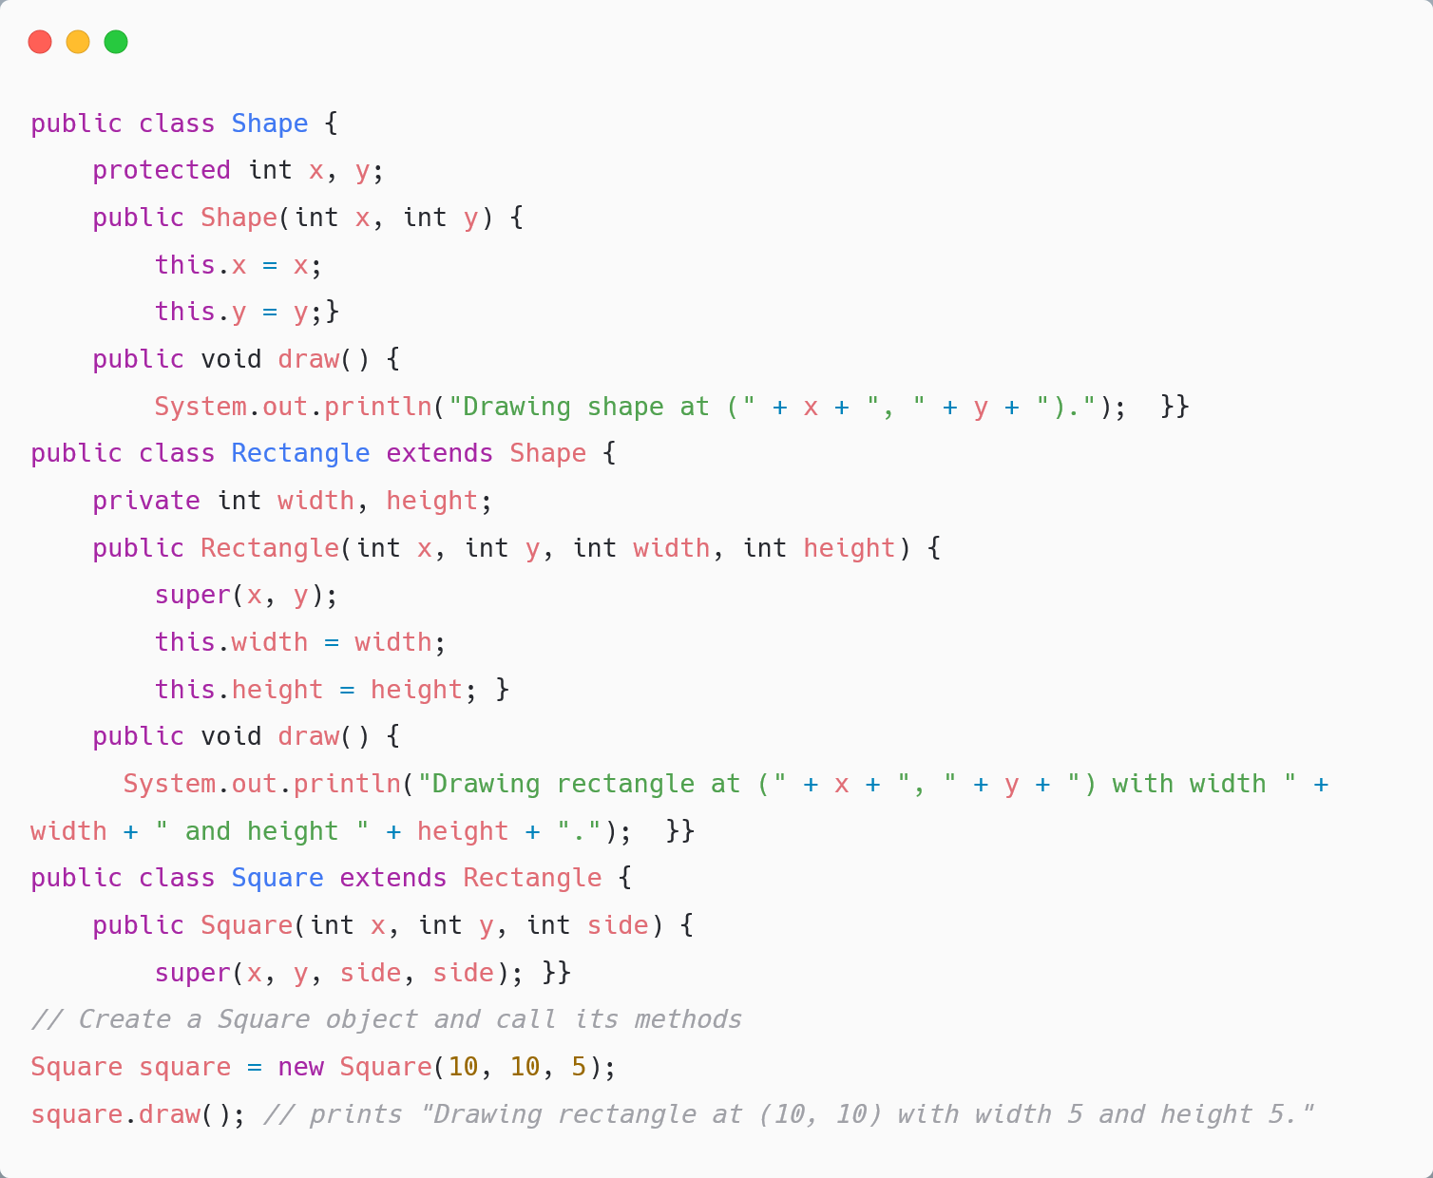
Example
In this example, Square is a subclass of Rectangle, which is a subclass of Shape. The Square class inherits the x, y, width, and height properties from its superclasses. The Square class overrides the draw() method of its Rectangle superclass to draw a square instead of a rectangle.

Slide 13
Reference :
https://www.google.com/url?sa=i&rct=j&q=&esrc=s&source=web&cd=&cad=rja&uact=8&ved=0CAMQw7AJahcKEwi43I7J3oP-AhUAAAAAHQAAAAAQAg&url=https%3A%2F%2Fwww.javatpoint.com%2Finheritance-in-java&psig=AOvVaw1KQrXGXkpG_g8vYw7Sub_e&ust=1680266245497423

Slide 14
Thank You

